Slide 1
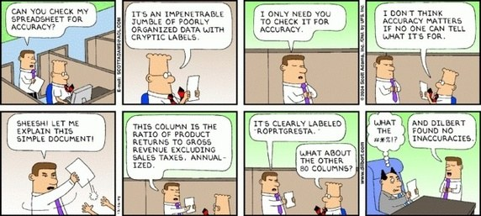
Escaping Excel Hell with Python
Summer 2016
Chong Her
Josh Johnson
Rachel Weyker
Dara Rodziewicz

Slide 2
Data Wrangling
Data wrangling is loosely the process of manually converting or mapping data from one "raw" form into another format that allows for more convenient consumption of the data with the help of semi-automated tools.
https://en.wikipedia.org/wiki/Data_wrangling

